Slide 1
Cognitive Services
Multiclass Text Classification using Deep learning

Slide 2
Objectives
Objective 1
Objective 2
To showcase the different artifacts of cognitive service in field of Text classification such as different type of vectorizers , ML/DL models, data Preprocessing
Showcasing the advantages and utility of Deep learning models as compare to the machine learning models in the field of text classification

Slide 3







Text Classification as a Process
A generic text classification problem involves the Following Steps
Step 1: Data Preprocessing
Step 2: Text Vectorization
Step 3: ML/DL algorithm
Step 4: Performance Validation
It involves various activities such as data cleaning , data validation, consistency etc.
Sequence of text converts to vectors to feed it in the ML/DL algorithm
Business Challenge: To find a suitable vectorizer according to type of Text
It consist feeding of vectors in to model , model development , training over data
Business Challenge: Suitable ML/DL algorithm according to features and performance
Performance check over trained model using testing data set such as accuracy, recall, precision etc.

Slide 4





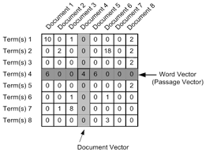
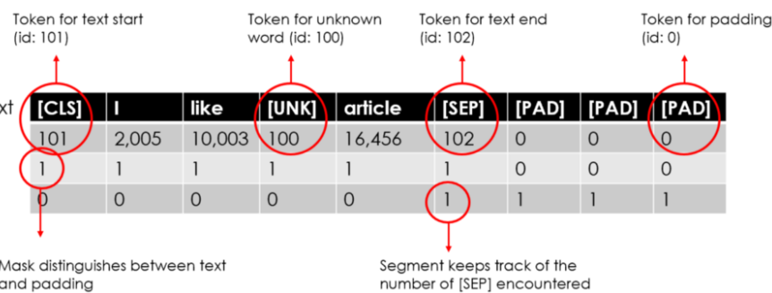
Different types of Vectorizer
TFIDF/Count Vectorizers
Word embeddings
BERT
Better for short sentences classification
Sparse representation of data
Lack contextual understanding as compare to other vectorizers
Either manually trains word embedding using deep learning layers or use pretrained vectors such as Glove Vectors
Dense representation of data
Good for sentiment analysis/contextual tasks
The vector BERT assigns to a word is a function of the entire sentence
Contextual Understanding
Good for language models

Slide 5
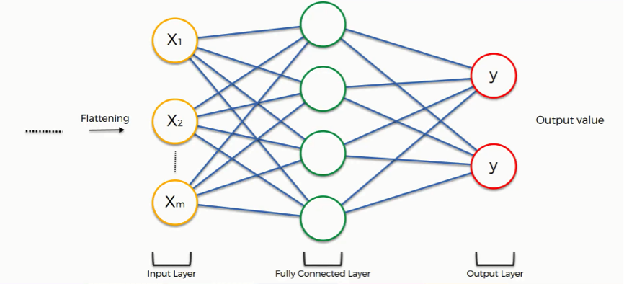
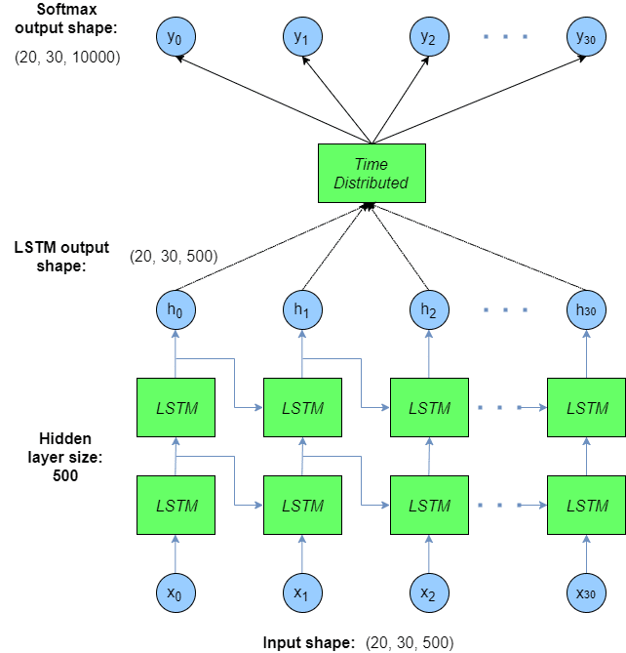
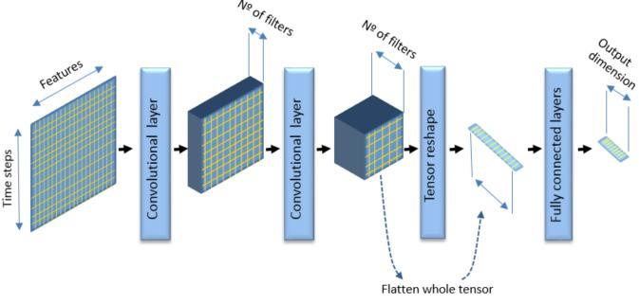
Different types of DL Models
Fully Connected Layers
CNN
LSTM
All layers are connected with each other
Overfitting of data due to each neurons connected with successive layer
Generally for computer vision/image processing but Conv1d layers can be used for text
Each neuron is connected to small number of layers
Regularization is possible
Artificial recurrent neural network architecture
Feedback connection
Can process whole sequence of data
Useful for sequential text

Slide 6







Text Classification Pipeline
Input Layer
DL Model Layers
Output/ Interaction Layer
Feature Engineering
Vectorization
Model Deployment
Extract Features/ EDA/Cleaning
State of art Vectorizers
Probability Score
High
Deep Layer Training
Retraining
Extract the Data from Data base
Medium
Low
Predicted Class
Manual Threshold

Slide 7
Proof of Concept

Slide 8
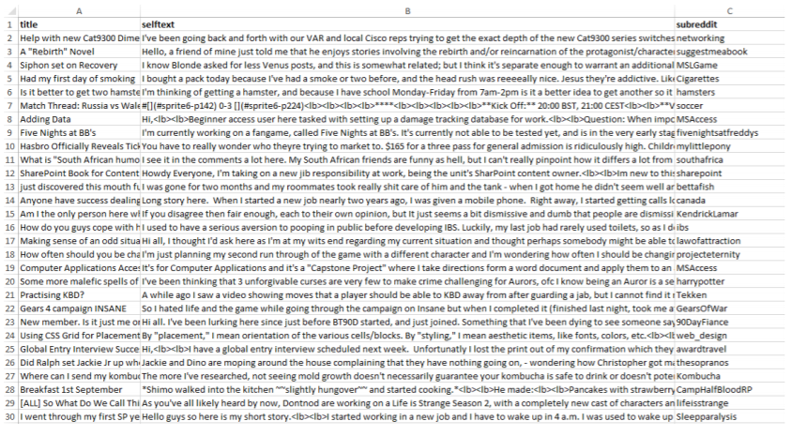
Dataset Information
For the POC purpose we used open source data from Kaggle which satisfy our feature requirements
Data Source : The reddit self-post classification task – Kaggle
A. Features
B. Statistics
1- Title (input)
2- Self text (input)
3- Subreddit (Output or category)
Number of Unique categories = 1013
Number of Data Points ~ 1 M
Example per class ~ 1000

Slide 9



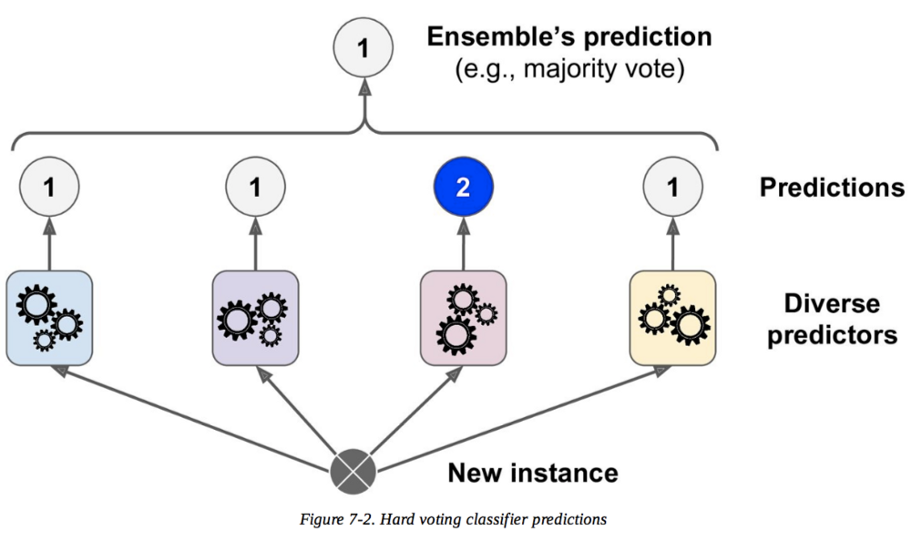

Solution Design
Deep Learning Method
Database
Vectorized Shipment
Extract Feature
Data
Pre-Processing
DL Model (LSTM, CNN, Fully Connected Layers
Vectorization
Predicted category
Machine Learning/Conventional
Data
Pre-Processing
Features
Text
Categories
Vectorization
Nearest Text Cluster
Predicted category
Clustering
Classification
Algorithm:
K-Nearest Neighbor
Algorithm:
Logistic Regression

Slide 10
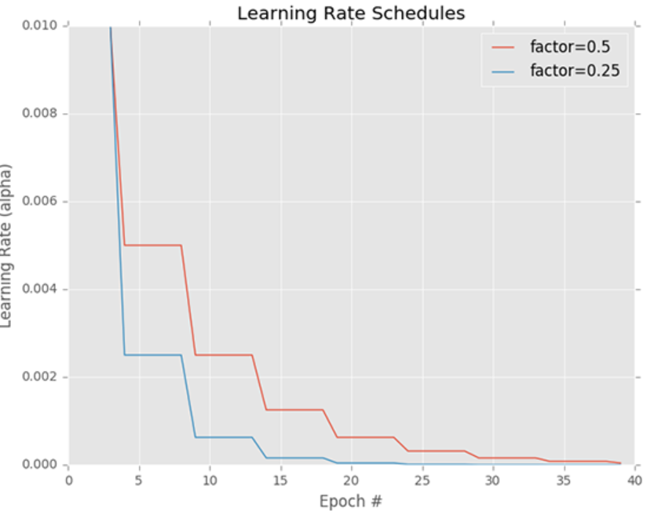
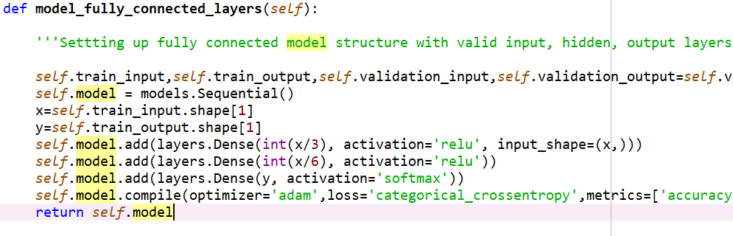
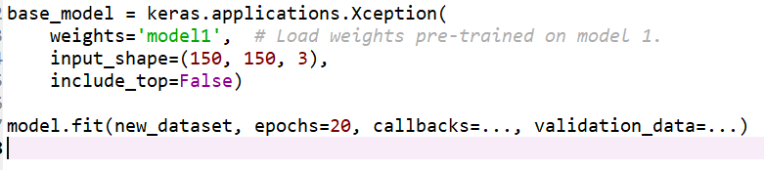
Model Architecture
Layers
Automated Training
Transfer learning
We used the Fully connected model to train the data which consists of sequential layers
ADAM optimizer, RELU, SOFTMAX as activation functions
Using callbacks to automate the optimum number of epochs
Pretrained Glove vectors, word2vec
Having less number of data points?
Use previous trained model weights over the top of new model

Slide 11
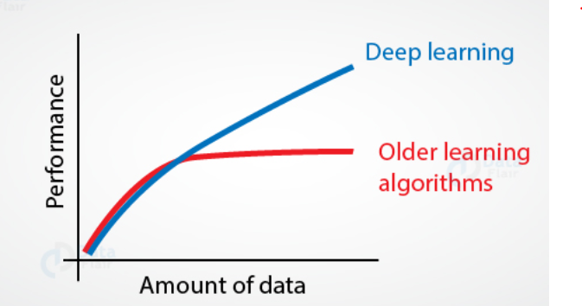
Performance Statistics
Accuracy
Volume of Data
Number of Classes
We fed the data both in conventional model as well as in deep learning model
Following are the accuracy statistics
For High data volume applications , conventional models has limitation of learning weights , deep learning models can overcome this problem
Conventional Machine learning algorithms are designed for the less number of classes.
In Conventional models if the number of classes increases than performance goes down
Deep learning models can handle large number of classes with satisfactory performance

Slide 12






Deep Learning Model: Business Value
Intelligence Layer
Benefits
Process Improvements
Intelligent Feature Engineering
Increased process Efficiency
Better performance over conventional models
Automated training
Reduced Errors
Can handle large number of classes
Transfer learning /Freezing
Business Value Generated
Impact on Key Metrics
Cost saving due to less number of errors
Improved Productivity
Increased Customer
Satisfaction
Increased accuracy/recall

Slide 13
Applications/Future scope
Risk analytics
Chatbots
Sentiment analysis
Fraud detection
Credit risk assessment
Spam filtering
Automating hiring process which involves resume classification, NLU
Interactive chatbots using NLP
Next word prediction
Clinical data classification based on text
Social Media Analytics
automatically selecting the most appropriate ads with respect to a Web page
Recruitment
Healthcare
Advertising

Slide 14
THANK YOU

